Slide 1
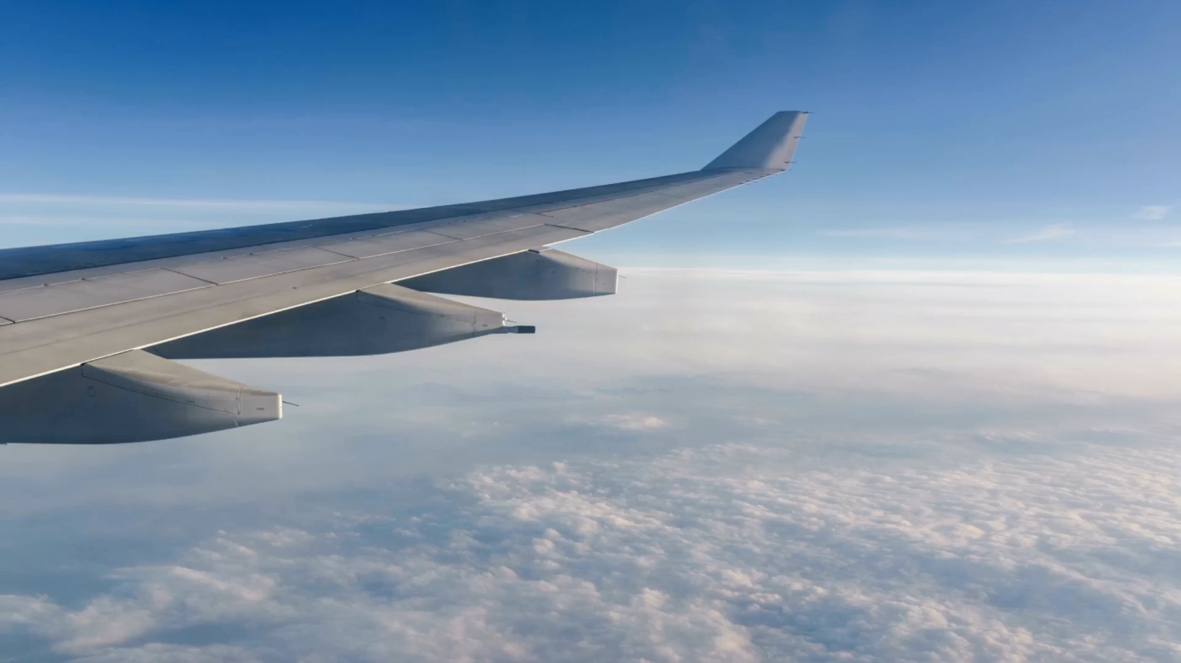
Airline flight Delays a data analysis
Dylas Snyder, Aldrich Villanueva
Dr. Jongwook Woo
CIS 3200
Fall 2025

Slide 2
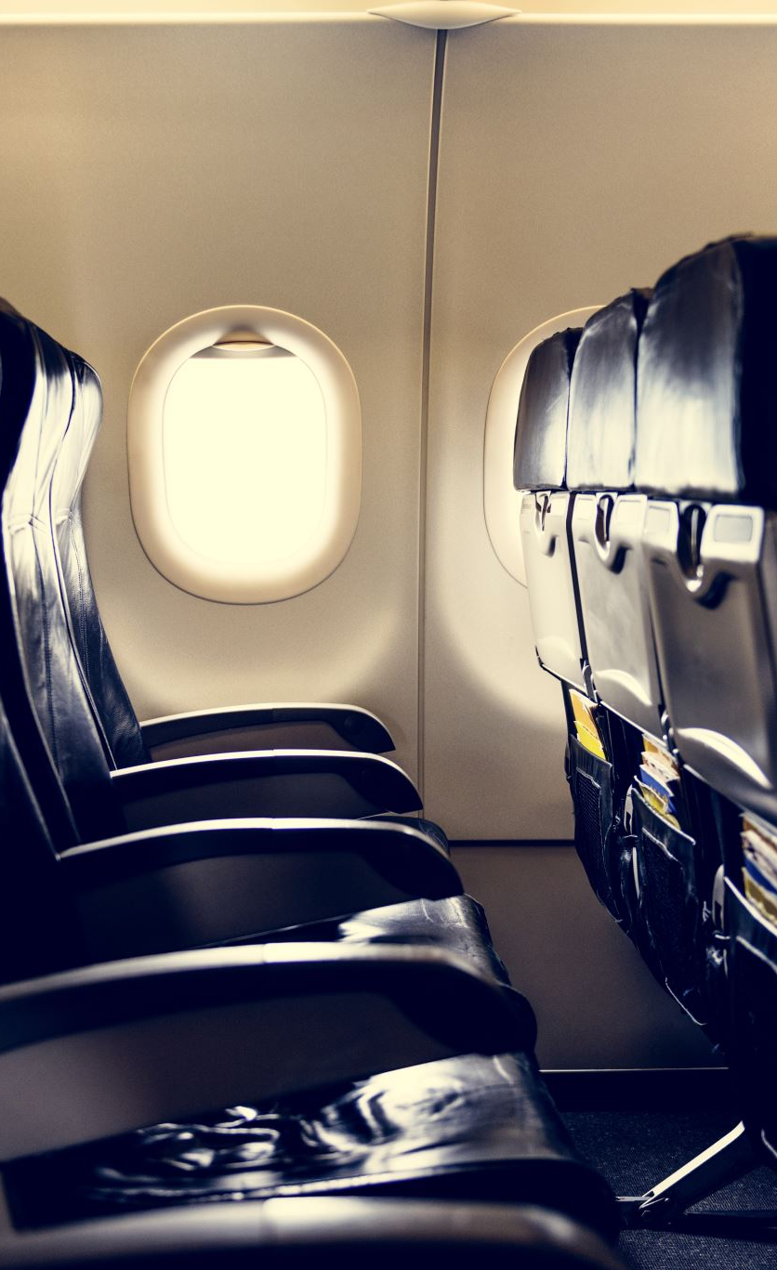
Our dataset…
Dataset contains 539,000+ U.S. domestic flights
Flights span 40 airports across the United States
File size: ~18.5 MB (.csv format)
Sourced from Kaggle: https://www.kaggle.com/datasets/jimschacko/airlines-dataset-to-predict-a-delay/data
Why this dataset?
Large enough for ES analysis
Contains rich temporal and spatial data
Ideal for delay visualizations and prediction models

Slide 3
How we plan to use our data
We will explore weekly delay frequency, delay distribution, and delay concentration
Create charts and other visualization tools to identify the following:
Patterns by weekday
Patterns by airport
Patterns by season/time
Use Elasticsearch services for:
Data ingestion & cleaning
Query and aggregation
Building dashboards in Kibana
Final goal of predicting which days experience the highest likelihood of flight delays
Notes:
We plan to analyze our data regarding airline flight data to visualize and possibly predict delay occurrences per week in the form of creating charts and graphs to help show the frequency and areas of concentration (if any notable one exists) of these delays.

Slide 4

Project goals and research questions
Primary Goals
Identify temporal patterns (days per week) in U.S. domestic flight delays
Identify spatial patterns (airports and states/cities)
Build a simple delay-prediction model using Elastic ML
Research Questions
Which delays of the week have the highest delay rates?
Do delay patterns cluster around specific airports?
Can ElasticSearch ML detect or predict high-delay days?

Slide 5

Data processing and elastic index structure
Data Processing Steps
Uploaded CSV dataset into ES Kibana MachineLearning
Applied ingest pipeline to parse time into usable time format
Convert numeric fields into integers
Standardize categorical fields as keywords
Convert delay into a Boolean label for ML
Elastic Index Structure Index Name: us-flight-delays-index
id (integer) unique id for each flight
airline (keyword) carrier code
flight (integer) flight number
airportfrom (keyword) departure airport
airportto (keyword) arrival airport
dayofweek (integer 1-7) represents the day of the week flight took place
time (keyword) converted to time of day
length (integer) flight duration
delay (boolean) whether flight was delayed or not

Slide 6


Temporal / Location Patterns
Visualizing ‘when’ and ‘where’ delays are occurring

Slide 7
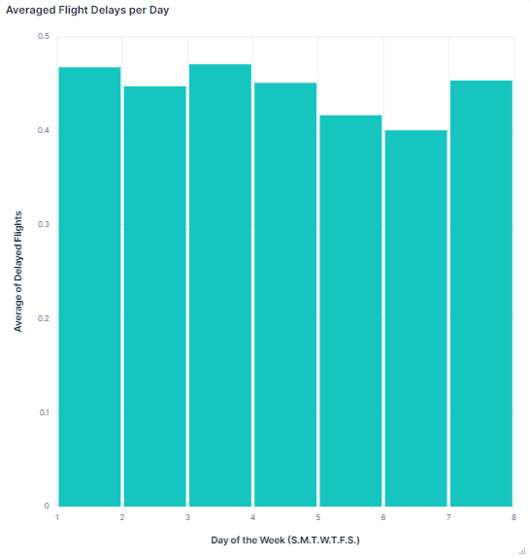
Flight delays vs day of week

Slide 8

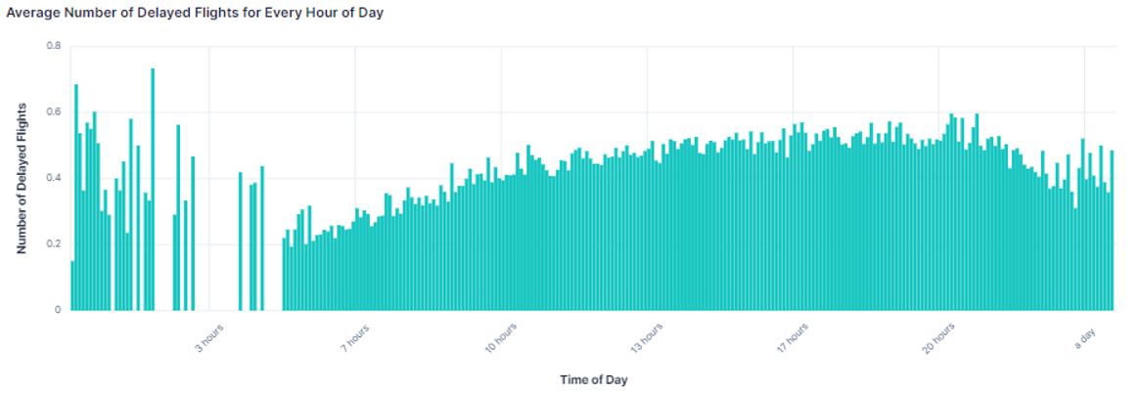
What time of day has the most delays?

Slide 9
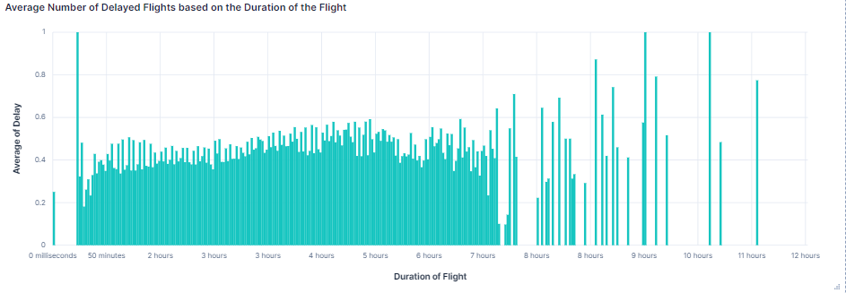
How does flight length impact delays?
There seems to be a trend of increasing likelihood of delay as the flight length increases

Slide 10
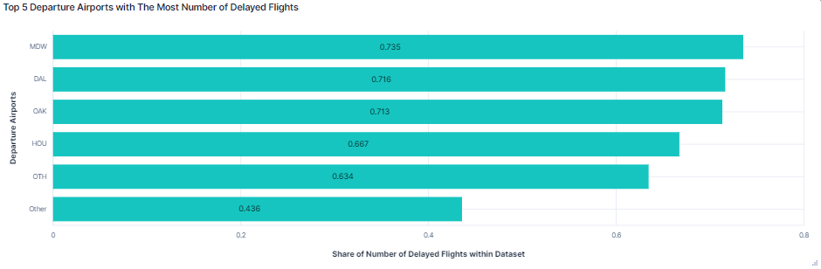
Which US airports have the most delays?
Chicago Midway seems to narrowly beat out Dallas Love Field and Oakland International in being the most common delay airport of this data set

Slide 11
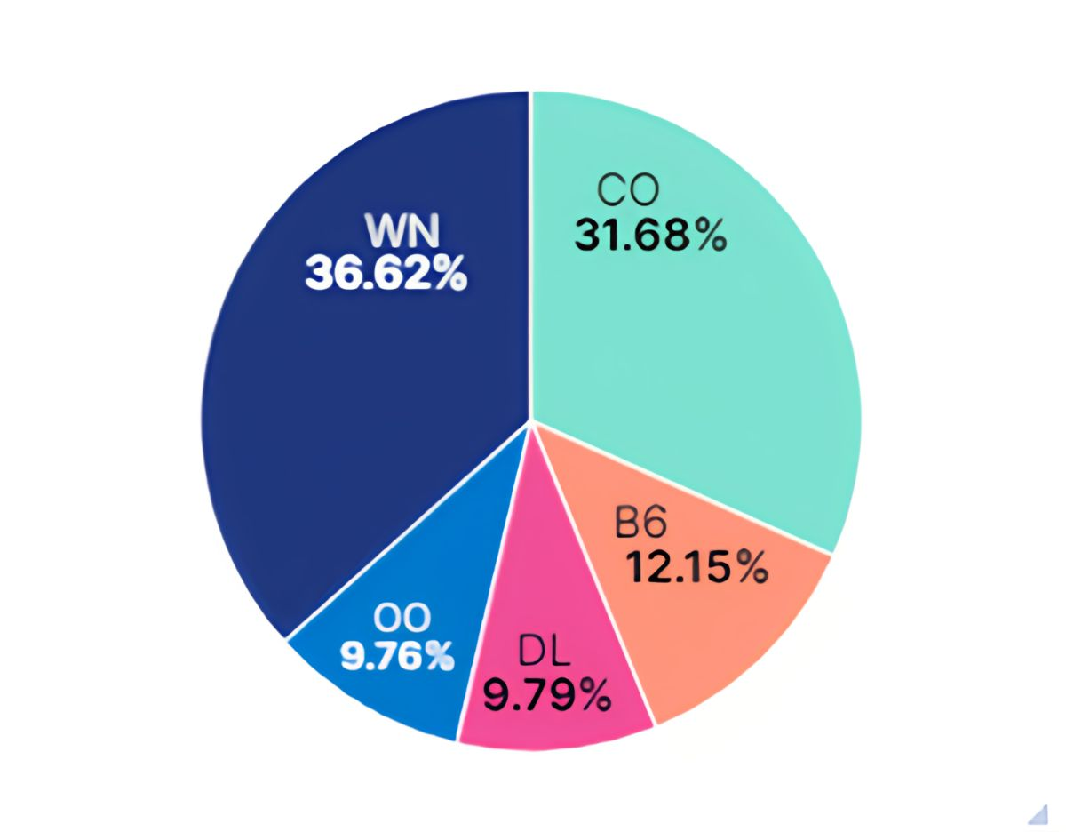
What airlines have the most delays of this data set?
WN = Southwest Airlines
CO = United/Continental
B6 = JetBlue Airways
DL = Delta Air Lines
OO = SkyWest Airlines

Slide 12
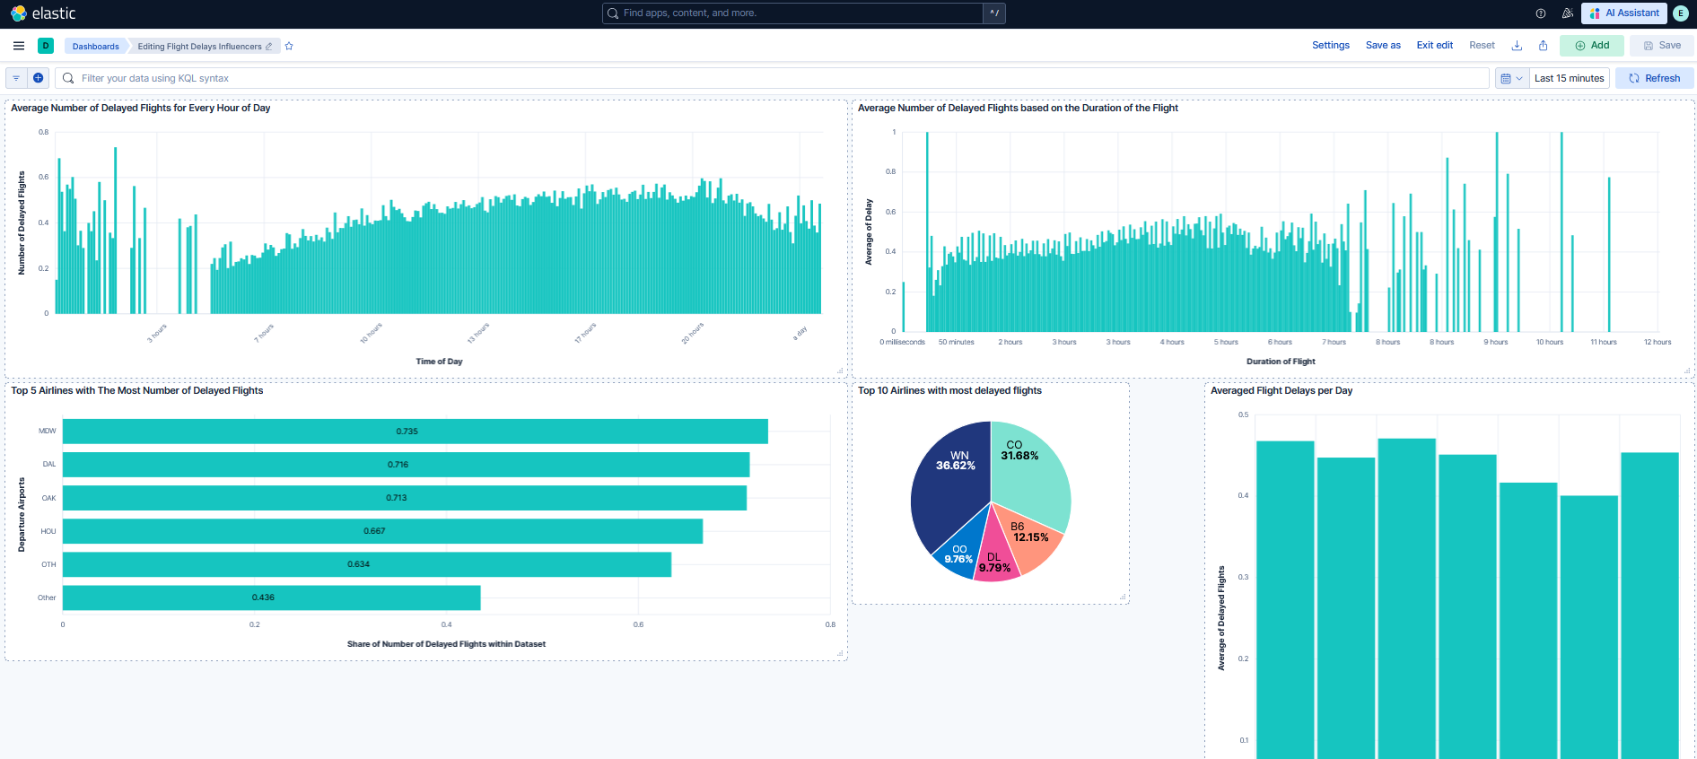
Dashboard View

Slide 13

Machine Learning
Modeling & Accuracy

Slide 14
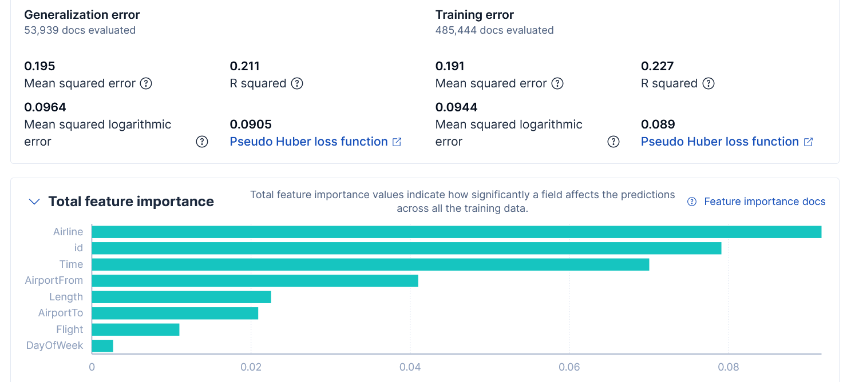
Error & Feature Importance

Slide 15
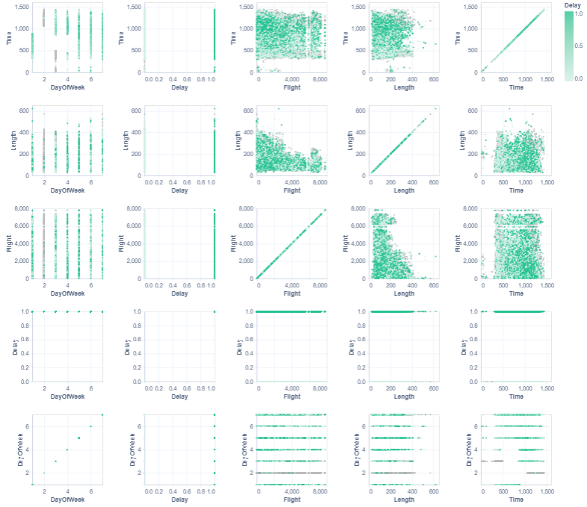
Scatterplots
Notes:
“Elastic ML successfully completed all 8 phases of model training and generated a regression model to predict flight delay likelihood.”
“Elastic ML trained on ~485k flights and tested on ~54k, giving us reliable model evaluation.”
“The strongest predictors of flight delay were Airline, Time of Day, and Departure Airport. Day of Week and Flight Number had only minor influence.”
“The regression model achieved an R² score of 0.21, meaning it captured approximately 21% of the variation in delay. While not highly accurate, this is expected given missing factors such as weather, air traffic control restrictions, and maintenance issues.”

Slide 16

Results, insights, and limitations
Key Findings:
Elastic ML successfully trained a regression model using ~540k flights.
Strongest predictors:
Airline
Time of Day
Departure Airport
Weak predictors:
Flight Number
Day of Week
Model performance:
R² = 0.227 (low-moderate predictiveness)
MSE = 0.191
Indicates delays are influenced by many external factors not in our dataset (weather, traffic, mechanical issues)
Notes:
Our model can identify high-risk combinations of airlines, airports, and times of day, but cannot fully predict delays due to missing external factors. Still, the results align with real-world expectations.

Slide 17

Conclusion
Overall Conclusion
ElasticSearch proved effective for:
Handling large datasets
Creating informative visualizations
Building a reproducible ML workflow
While delay prediction is partially possible, flight delays remain complex and influenced by real-world variables outside operational data.
Machine Learning Insights
Elastic ML identified Airline, Time of Day, and AirportFrom as the strongest predictors of delay.
Weaker predictors included Flight Number and Day of Week.
Model performance: R² = 0.227, MSE = 0.191 — moderate predictive power.
Interpretation
The model captures predictable patterns from the data but cannot fully predict delays due to external factors not present in the dataset (weather, air traffic control restrictions, mechanical issues).
Notes:
“Our analysis shows that flight delays follow identifiable patterns—certain airlines, airports, and later times of day experience higher delay rates. Using Elastic ML, we built a model that found Airline, Time of Day, and Departure Airport to be the strongest predictors. The model’s R² of 0.21 shows moderate predictive power; delays are still heavily impacted by external factors such as weather and traffic that were not in our dataset. Overall, ElasticSearch allowed us to efficiently visualize trends and build a reproducible prediction model.”

Slide 18
References
Dataset: https://www.kaggle.com/datasets/jimschacko/airlines-dataset-to-predict-a-delay/data
Airport / Airline IATA : https://www.iata.org/en/publications/directories/code-search/

